Slide 1



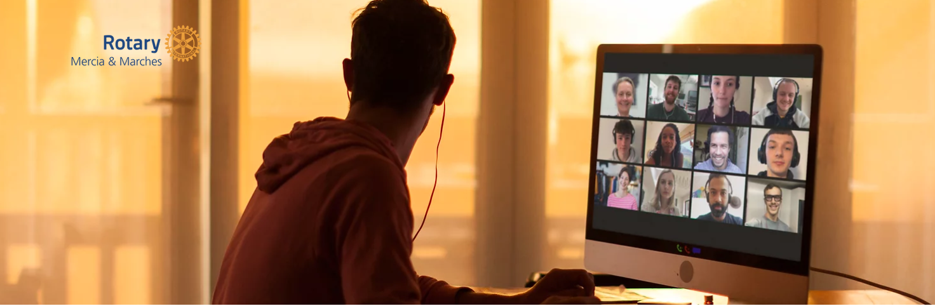
A passport club that
will operate less formally than the traditional Rotary model
meet primarily online
members do what they can, when they can

Slide 2
Our objective is to provide a more flexible and diverse membership
We want to ensure everyone has equal access to our resources and opportunities
We are committed to EDI (Equality, Diversity and Inclusion) and welcome all individuals to join us in M&M Rotary
Equality means that each person has access to the resources, opportunities, networks and support they need to thrive.
Diversity is recognising, respecting and celebrating each other's differences.
Inclusion means creating an environment where everyone feels welcome and valued.

Slide 3
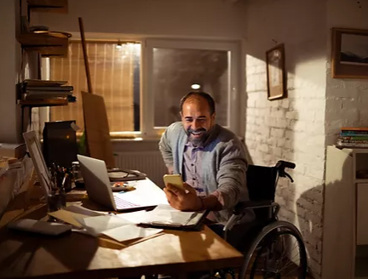
Rotary & Disability
We would like to help ensure that all children, young people and adults with disabilities are able to live a healthy, full and fulfilling life in the way they choose.
We want to see people living with disabilities becoming full citizens, members of their communities and part of the Rotary Family

Slide 4
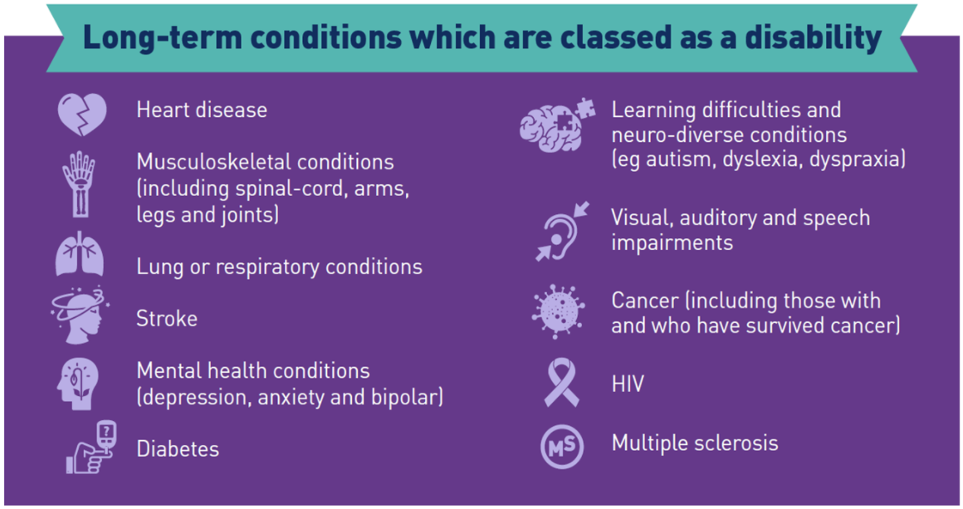

Slide 5
Disability facts and figures
There are 14.1 million disabled people in the UK
8% of children are disabled
19% of working age adults are disabled
46% of pension age adults are disabled
Source: Family Resources Survey (2019 to 20)

Slide 6

Common Barriers restricting Rotary Membership
Attitudinal
1 in 3 people see disabled folks as being less productive than non-disabled people.
Source: Scope - Disability Perception Gap (2018)
Communication
These barriers are experienced by people who have disabilities that affect hearing, speaking, reading, writing and or understanding, and who use different ways to communicate.
Communication with the person!

Slide 7
Physical
Changes in society remove barriers for everybody. It's better to change our environment and attitudes rather than try to change people with impairments or differences
Transportation
Lack of buses, public transport entry and exit access problems, taxi?
Requirement to stop driving
Social
Source: Scope - The disability price tag (2019)
Life costs you £583 more on average a month if you're disabled.
People with disabilities are far less likely to be employed than those without a disability

Slide 8
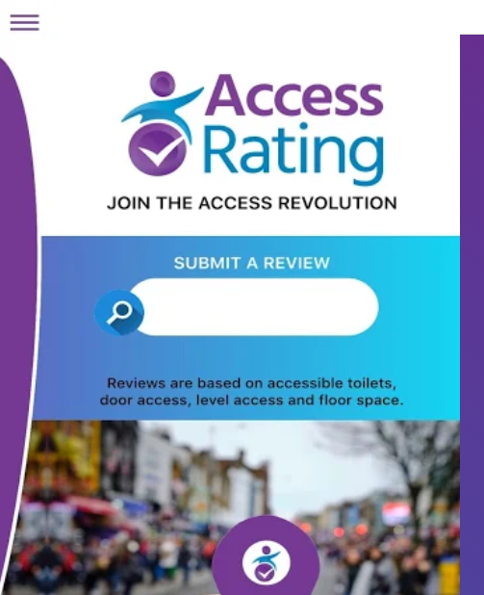
Access to Rotary
All m&m rotary members use Access Rating App when out and about everyday www.accessrating.com/app
Please invite us to visit your Club
Visit all Rotary Club venues in D1210 initially to consider disability access

Slide 9
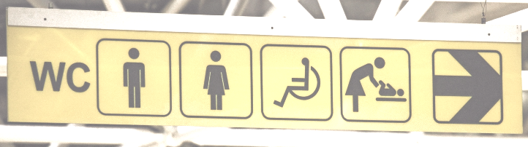
We will be using use an approved audit checklist indicating access to the buildings and all internal facilities
Risk assessment to include looking for
Immediate access to the building, steps, ramps, lighting, car park lighting and surfaces
Are all areas available to wheelchair users
Hearing Loop, Disability Toilets, Blue Badge Parking
Share these findings

Slide 10
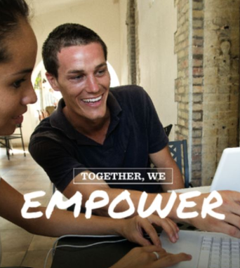
Rotary & Disability
Highlighting Rotary & Disability
Increase Awareness
Bring about Change
Include everyone
Increase Rotary Membership

