Slide 1
Membership Extension & Retention
Les Goodchild MBE
District 1210 Membership Extension Retention Lead
Rotary Club of Newport Lite

Slide 2
Welcome
Thank-you for joining me

Slide 3
Aims of this brief:
Promote greater understanding of the challenges in developing membership retention and growth
Promote greater awareness of the flexibility within Rotary to operate a ‘style’ of Rotary commensurate with your membership goals
Seek to understand what the District 1210 membership committee can do to support clubs within the District
Establish ways to grow our membership base

Slide 4
Impact of Coronavirus
There can be little doubt that more than any time in several decades, our local communities are going to need our support beyond the current crisis
Many of our clubs are playing a critical role in support of their local communities across D1210 during this current crisis – thank you!
It is important to remain connected throughout this current crisis. Many of our clubs are doing so really effectively. Failure to do so may adversely impact on membership renewal as some feel disconnected or perhaps undervalued by Rotary
Equally important, we need to look to the future and consider what support our communities are going to need as we adjust to what will undoubtedly be a changing landscape
We have a great story to share!

Slide 5
Health warning!
I don’t have all the answers – I am just a Rotarian
Each of our clubs are different and therefore, in addressing membership issues, will have different requirements
My hope is to generate discussion and achieve progress as a result of shared experience/knowledge

Slide 6
Membership continues to be our number one priority, both retaining existing members and developing opportunities for new Rotarians to help us continue our work and to
“Do Good in the World”.

Slide 7
Alone we can do so little – together, we can do so much!

Slide 8
Why it is important to maintain and seek to grow our membership profile?
Please use the comments box to input your thoughts

Slide 9
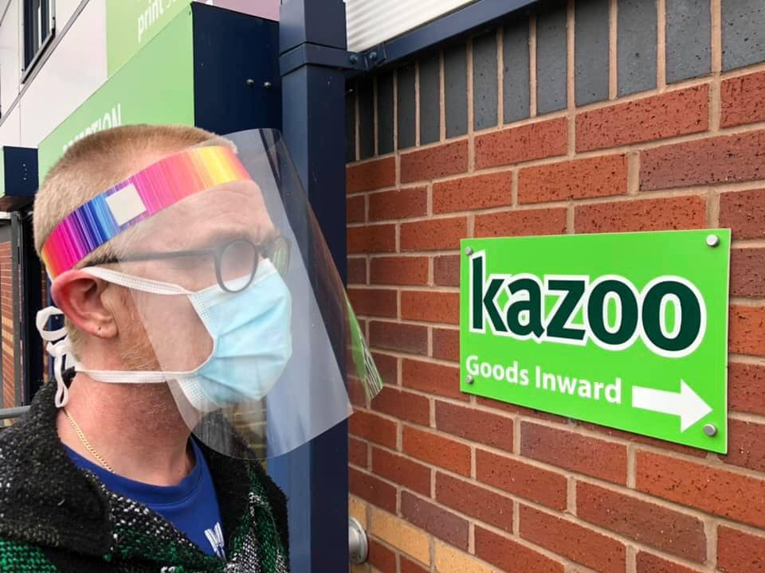

Slide 10
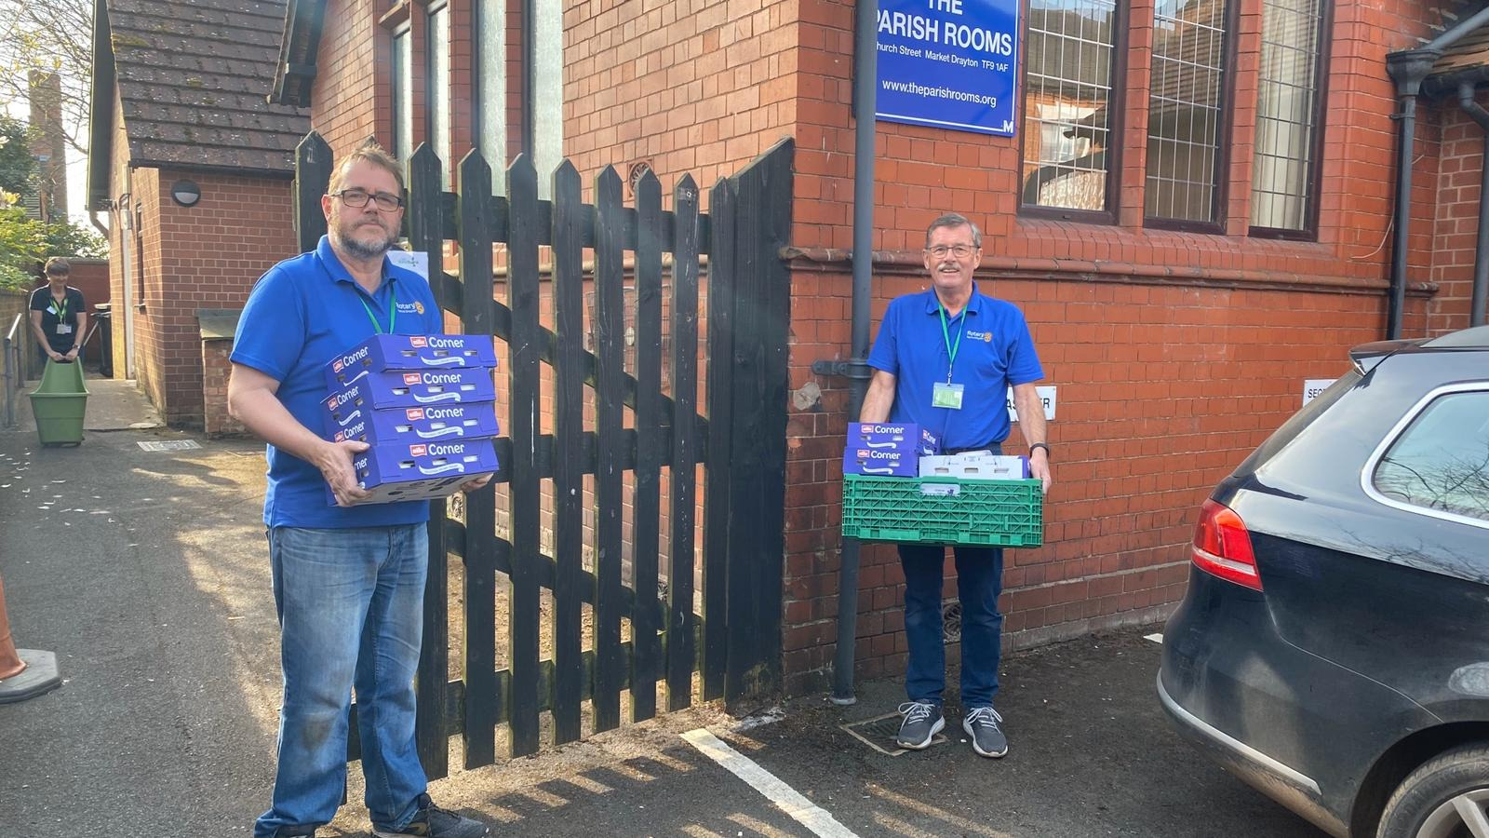

Slide 11
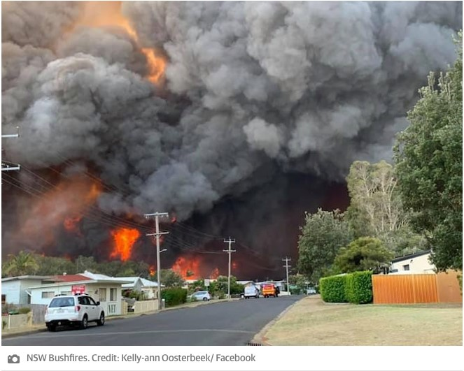

Slide 12
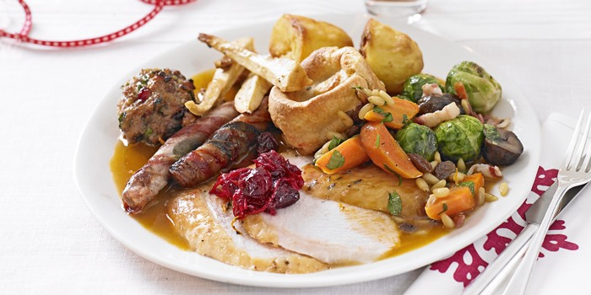

Slide 13
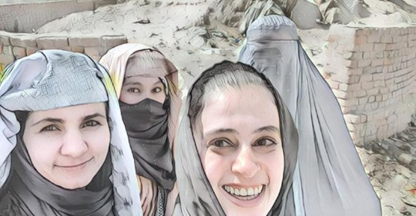

Slide 14

Sorry…… a few stats!

Slide 15
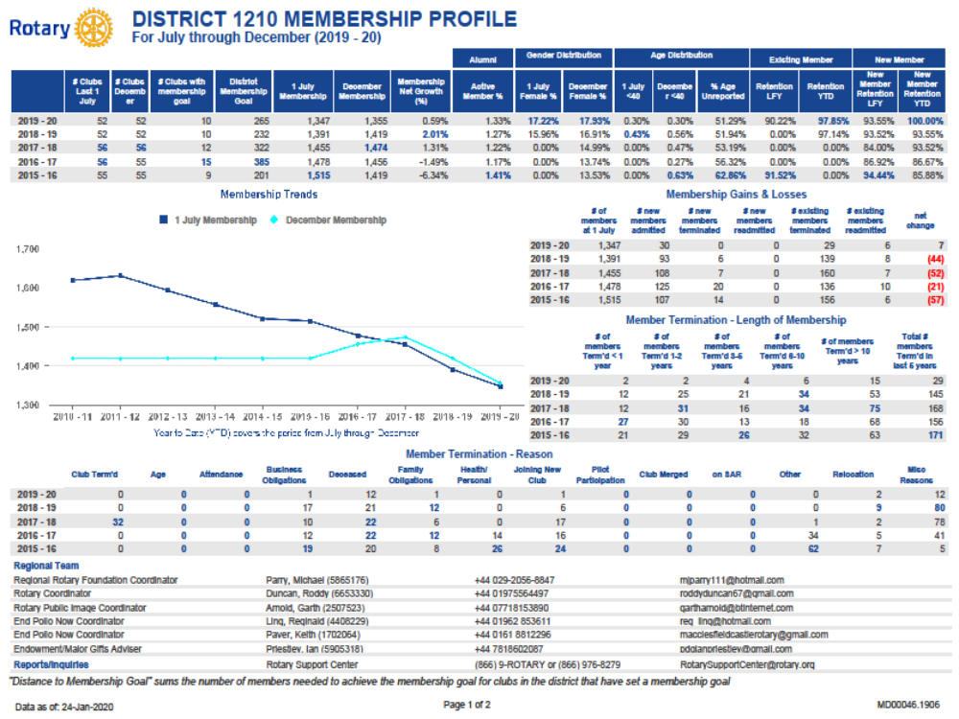

Slide 16
Thought provoking stats?
75% of our clubs meet on Tues, Weds or Thurs
38 of our 52 clubs meet in the evening
Only one club meets at the weekend
There is a population of c2M in or District
with a ratio of 1 Rotarian per 500 people, we could achieve a membership of 4000 (that’s the ratio that exists in D1010. Their worst ratio is 1 in 8000. This figure would almost double our membership in 1210 to c2500
The Age Profile in D1210 shows that over 54% of the population are prime age for new Rotarians (18 – 59)
51% of the population is female. Data from RGBI tells us that only 17% of the Rotarians in D1210 are female.

Slide 17
It’s not about ageism – it’s about age distribution and our natural life cycle
<30 30-39 40-49 50-59 60-69 >70
0% 1% 5% 14% 30% 50%
Data - Ken McLennan
RGBI Membership Team
Mar 19

Slide 18
Other Factors Impacting on Membership Growth
Membership is missing altogether in key areas
Opportunities for developing diversity beyond those already identified in the age profile example
Opportunities for wider membership opportunities through offering a different style of Rotary (more later)
Population centres (density) could support new clubs
Engaging our current membership – particularly those new to our clubs

Slide 19
Why is our diversity skewed and not representative of those eligible to be Rotarians from within our communities?
Please use the comments box once again to input your thoughts

Slide 20
RI President Mark Maloney insisted that while Rotary is looking at growth in some previously untapped parts of the world, the emphasis was on clubs in Great Britain and Ireland to reach out to untapped parts of their communities.
“One of the key points of my year is that in the UK and the USA, and in those countries where Rotary is ‘mature’, we need to be forming new, innovative, different Rotary clubs,” he insisted. “Because we are not serving all the segments of society.”

Slide 21
What is the inference of that statement?

Slide 22
“So I submit that where we need to be expanding Rotary is not just in those countries which have one club or a few clubs, but in communities where Rotary is thriving, because we are not serving members of those communities.
“Rotary clubs today are not doing anything wrong. We have many communities where we have fabulous clubs, doing fantastic work. They still attract new members, they are not collapsing, but we have got to start to segmenting our approach. “We need new, different, innovative Rotary clubs. “Some people may find this shocking, but there is nothing in Rotary’s constitutional documents which says that food is required to have a meeting.
RI President Mark Maloney

Slide 23
Looking to form new clubs is a great initiative. However, we must also seek to retain our existing members. To do that, we need vibrant, healthy clubs.
Question to ask ourselves
What is it that we don’t do that we once did....and why?

Slide 24
How do we know whether our club is vibrant and healthy?
If you are not sure, Rotary has a club health check proforma and a raft of other resources that may offer an insight to the health of your club

Slide 25
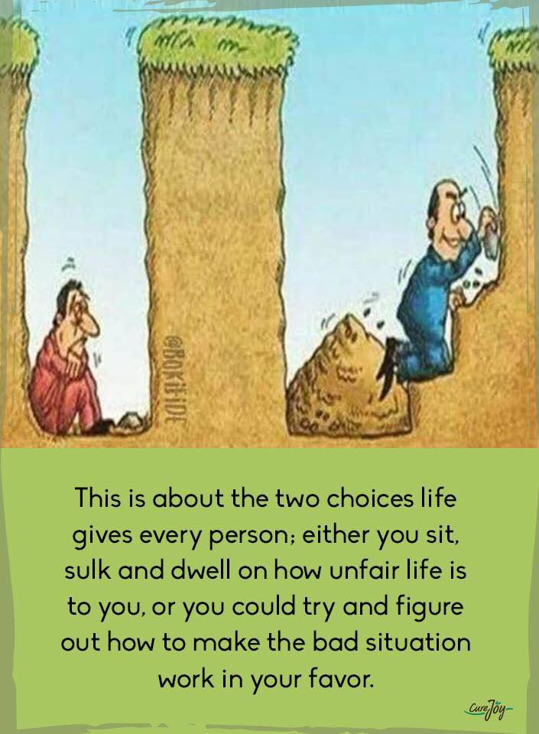

Slide 26
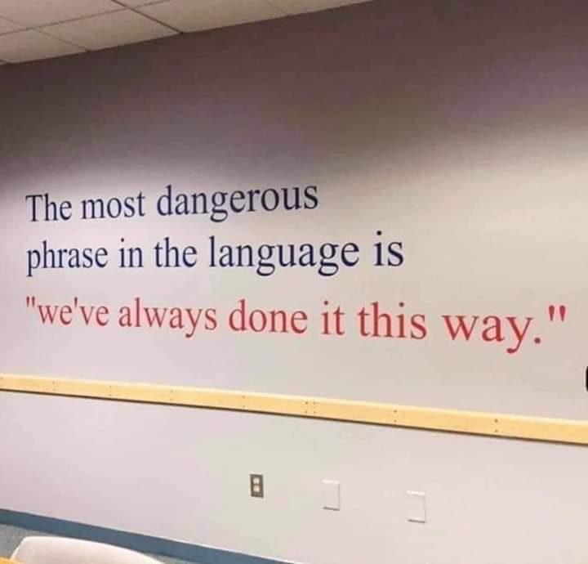

Slide 27


Slide 28


Slide 29
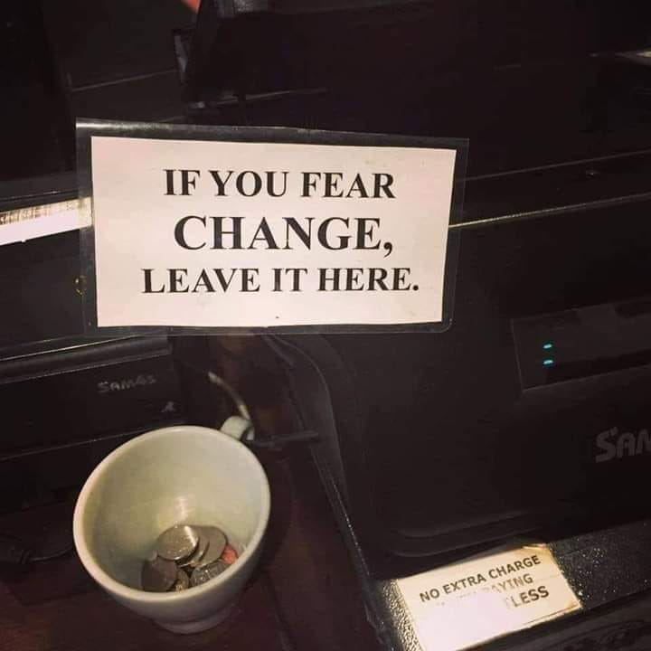

Slide 30
Rather than look at our Rotary experience from our own perspective, try and view it from that of a prospective new member coming along to the club for the first time
What are the barriers likely barriers that you might encounter in persuading that person to join?

Slide 31
We have already acknowledged that Rotary is a fantastic organisation, offers great opportunities and we do great work to support our communities and beyond
Therefore, why are people not rushing to join us?

Slide 32
Is the way our clubs operate representative of society around us?

Slide 33
A few thoughts of my own…..
We don’t do enough to publicise our great achievements
The current crisis has demonstrated that many within our communities are keen to help others yet we are unable to tap into that pool of volunteers – we need to establish why that is?
We must understand that we need to make volunteering relevant to the next generation
If we are unwilling to change the landscape within our own clubs, we should be willing to support the formation of new clubs to accommodate a more diverse membership

Slide 34
Cost of Rotary – a barrier?
It will be to some – so what can we do about it?
Why do we pay District and RI dues?
Are those dues good value for money?
What do those dues buy us?
Could we be more flexible in our payment options?

Slide 35
Rotary Club of Fort Collins
We got rid of the name "satellite" (sounded too paternal) and now say "we are one club with two meeting options, noon and evening".
Our 2nd meeting option meets twice a month in the evening at various breweries, distillers and restaurants.
We now have 27 members that attend the evening meeting. We get things done, talk about it on social media and have a good time ☺

Slide 36
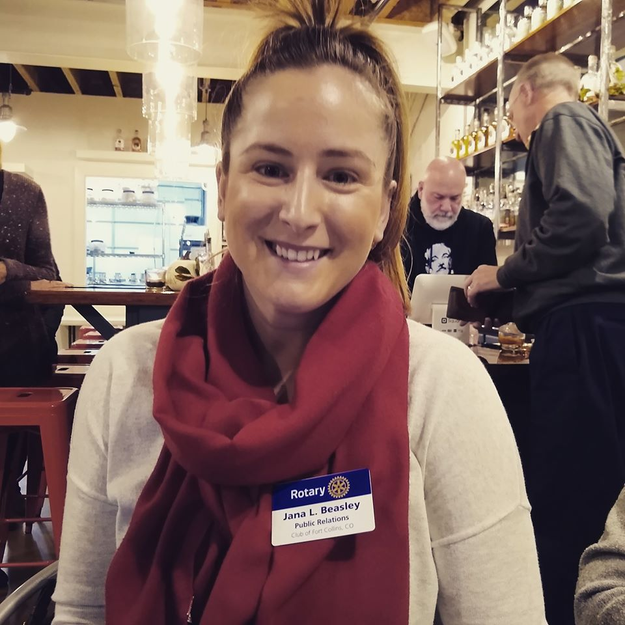

Slide 37
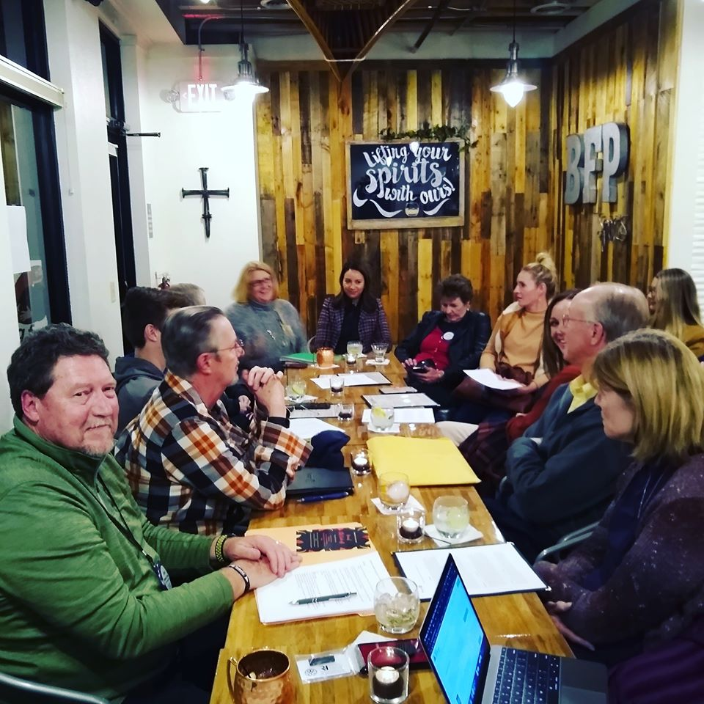

Slide 38
What Else Might Assist us in Growing Rotary?

Slide 39
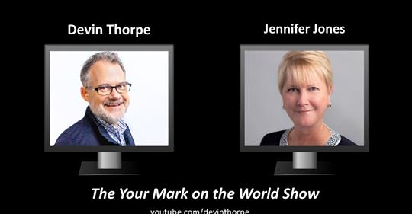
Rotary’s Top Female Leader Says Recruiting Women Is A Growth Opportunity

Slide 40
YOUTH!
Rotakids
Interact
Rotaract
Youth Competitions
Engagement with Schools
Engagement with Youth Organisations

Slide 41
Engagement with other local Organisations/Clubs
Sleigh helpers
Marshalling assistance
Fundraising partnerships
Development of a Rotary Community Corps

Slide 42
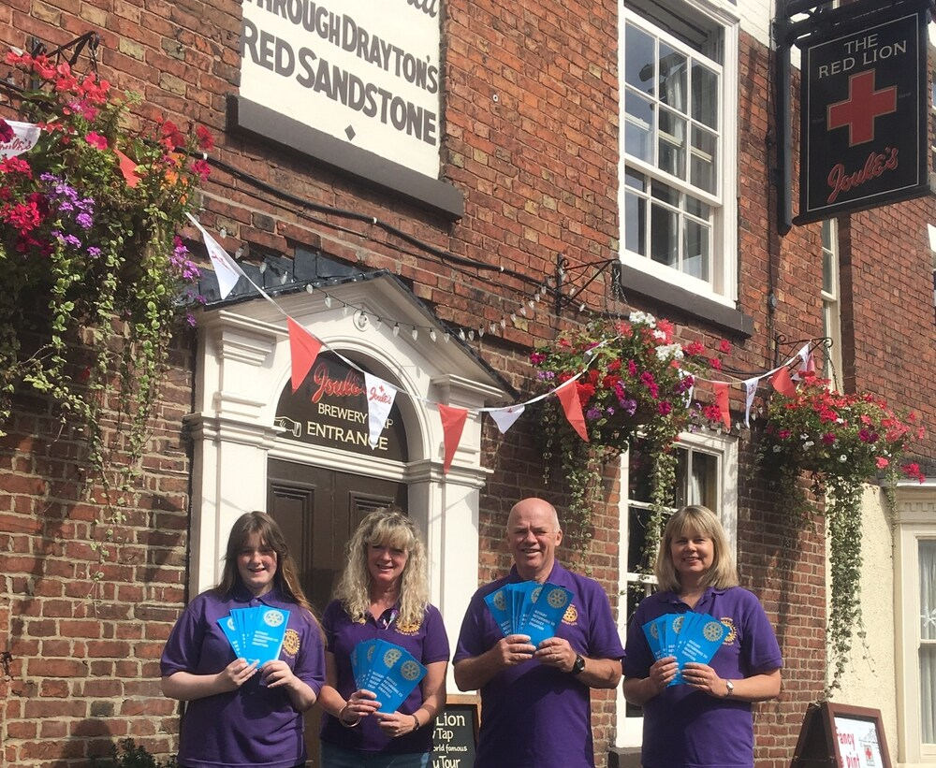

Slide 43
Over recent years Rotary rules have been changed to allow us to innovate and be more flexible in when, where and how we meet; how we manage attendance; the type of memberships we offer.

Slide 44
MER Committee
AG’s are members automatically by virtue of their role
Membership champions are sought to help develop ideas and grow our membership
Communication channels between the District team and clubs is of critical importance
The District membership team are a resource for clubs to use
Equipment to support membership drives is being purchased and available to loan

Slide 45
What do you want from your MER team?

Slide 46
Key Messages
Membership GROWTH is the responsibility of us all
Rotary provides for flexibility in how you deliver your style of Rotary
Traditional Rotary is fine, so is flexible Rotary – what counts is what suits your membership
An informal style of Rotary that affords service to our communities is STILL Rotary
The MER Committee is another support tool should you want help in growing/retaining your membership base
Both RI and RGBI have a wealth of resources online to help us increase our membership and manage change
https://my.rotary.org/en/learning-reference/learn-topic/membership

Slide 47

Thank you!

Slide 48
?

